Slide 1

MACHINE LEARNING

Slide 2
Machine Learning (ML)

Slide 3
ML is a branch of artificial intelligence:
  Uses computing based systems to make sense out of data
    Extracting patterns, fitting data to functions, classifying data, etc
  ML systems can learn and improve
    With historical data, time and experience
  Bridges theoretical computer science and real noise data.

Slide 4
ML in
Real-Life

Slide 5

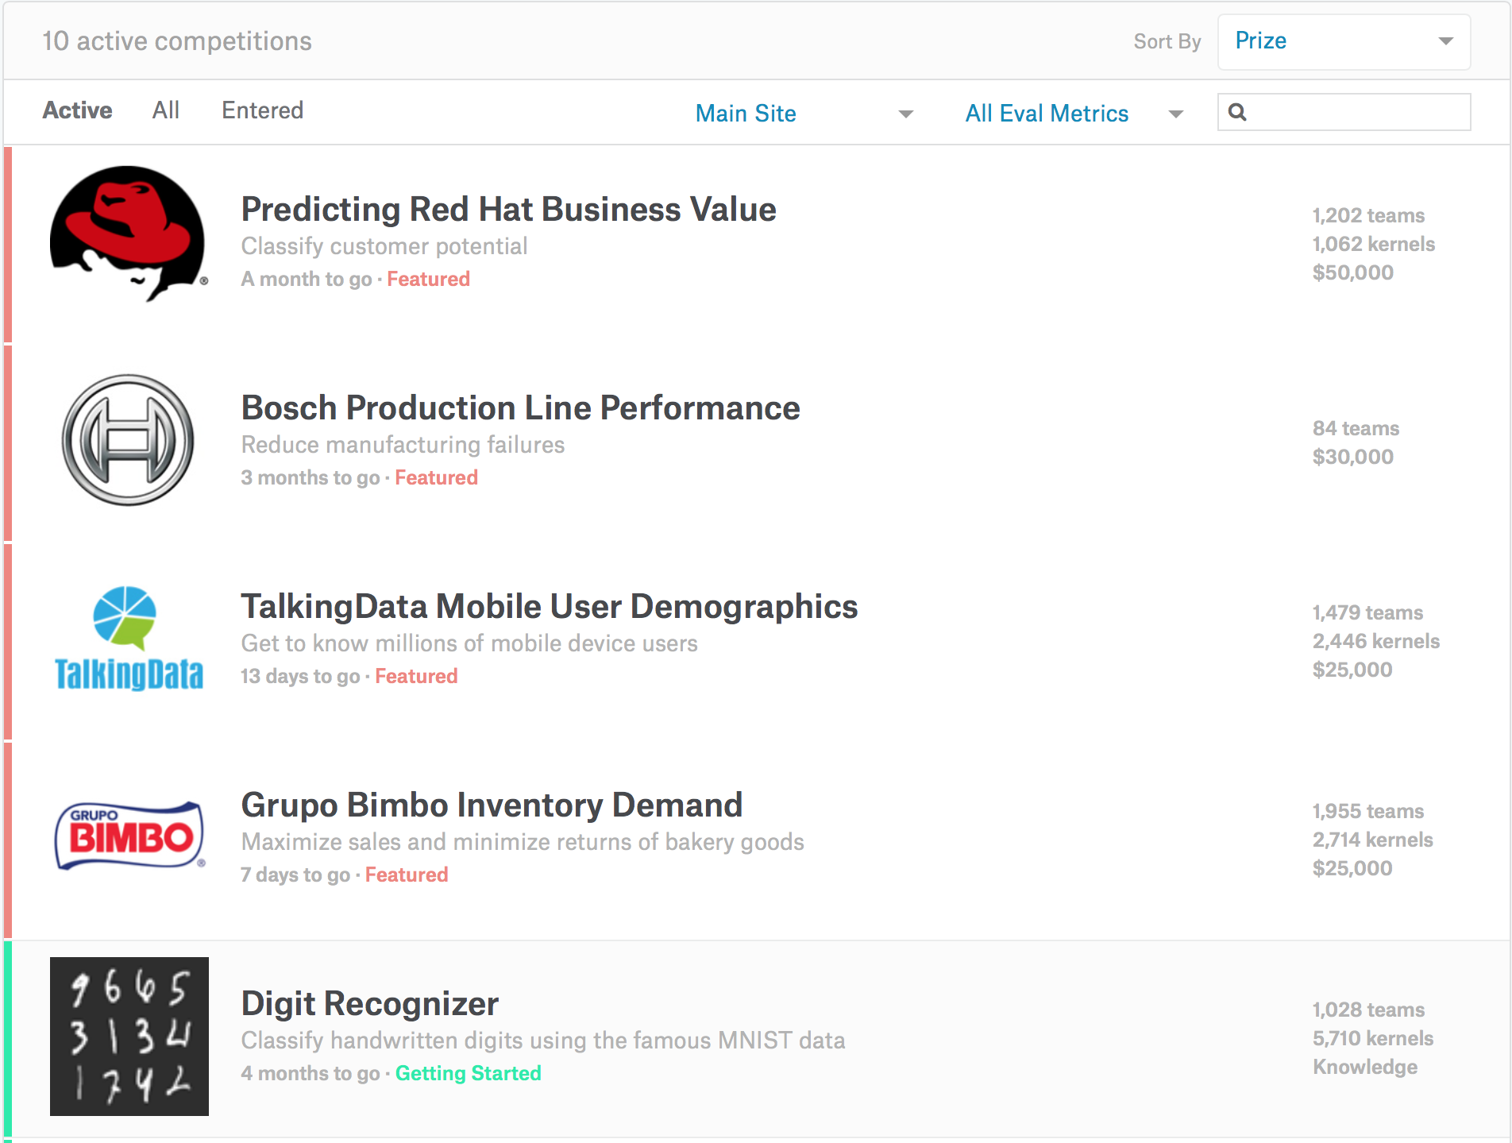


Slide 6
Supervised
&
Unsupervised Learning

Slide 7
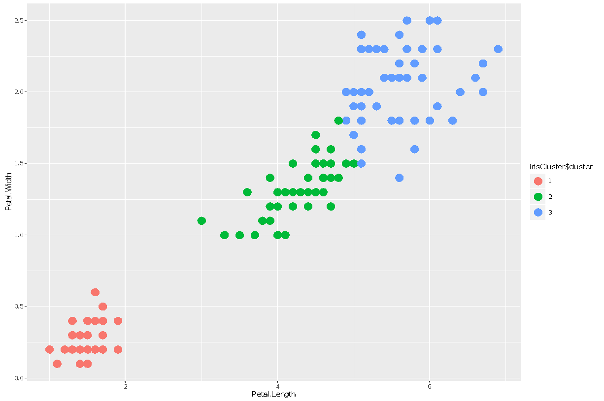
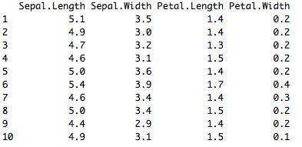
Unsupervised Learning
  There are not predefined and known set of outcomes.
  Look for hidden patterns and relations in the data
  A typical example: Clustering.

Slide 8
Supervised Learning
  For every example in the data there is always a predefined outcome
  Models the relations between a set of descriptive features and a target (Fits data to a function)
  2 groups of problems:
    Classification
    Regression

Slide 9
Supervised
Learning

Slide 10
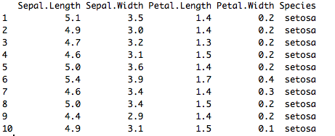
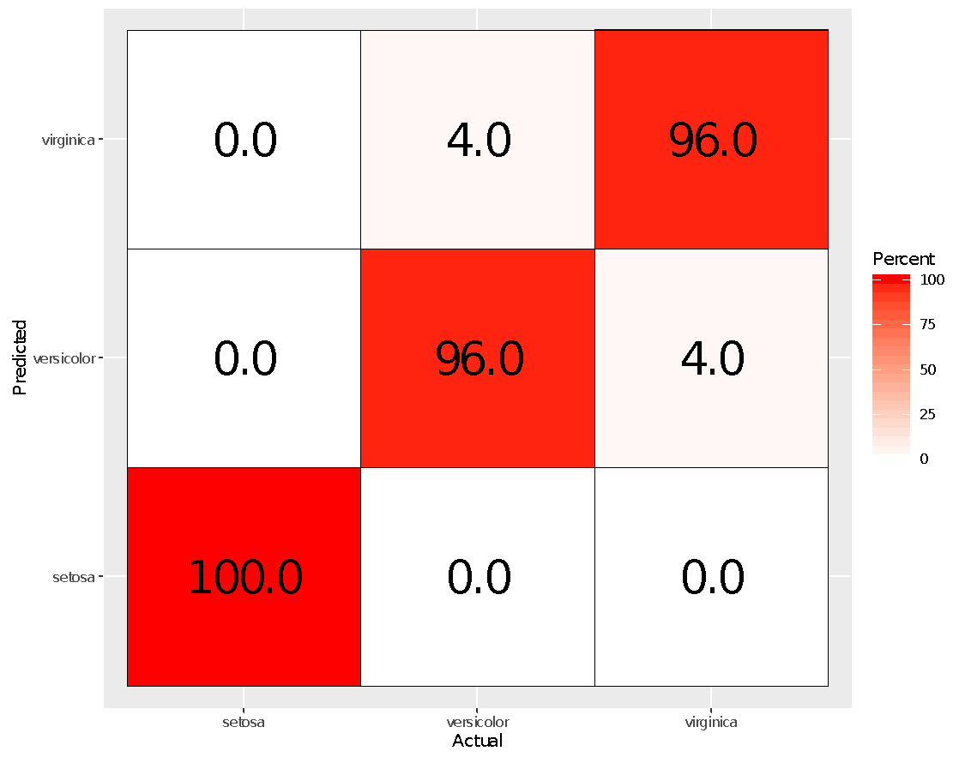
Classification
  Predicts which class a given sample of data (sample of descriptive features) is part of (discrete value).
Regression
  Predicts continuous values.

Slide 11
Machine Learning as a Process

Slide 12
Machine Learning as a Process
- Define measurable and quantifiable goals
- Use this stage to learn about the problem
Define Objectives
- Normalization
- Transformation
- Missing Values
- Outliers
Model Deployment
Data Preparation
Study models accuracy
- Work better than the naïve
approach or previous system
Do the results make sense in the context of the problem
- Data Splitting
Features Engineering
Estimating Performance
Evaluation and Model Selection
Model Evaluation
Model Building

Slide 13
ML as a Process:
Data Preparation

Slide 14
Needed for several reasons
  Some Models have strict data requirements
    Scale of the data, data point intervals, etc
  Some characteristics of the data may impact dramatically on the model performance
Time on data preparation should not be underestimated
  Missing Values
  Error Values
  Different Scales
  Dimensionality
  Types Problems
  Many others
  Scaling
  Centering
  Skewness
  Outliers
  Missing Values
  Errors
Modeling phase
Raw Data
Data Transformation
Data Ready

Slide 15
ML as a Process:
Feature engineering

Slide 16
Determine the predictors (features) to be used is one of the most critical questions
Sometimes we need to add predictors
Reduce Number:
  Fewer predictors more interpretable model and less costly
  Most of the models are affected by high dimensionality, specially for non-informative predictors
  Binning predictors
Wrappers
Multiple models adding and removing parameter
Algorithms that use models as input and performance as output
Genetics Algorithms
Filters
Evaluate the relevance of the predictor
Based normally on correlations

Slide 17
ML as a Process: Model Building

Slide 18
Data Splitting
  Allocate data to different tasks
    model training
    performance evaluation
  Define Training, Validation and Test sets
Feature Selection (Review the decision made previously)
Estimating Performance
  Visualization of results – discovery interesting areas of the problem space
  Statistics and performance measures
Evaluation and Model selection
  The ‘no free lunch’ theorem no a priority assumptions can be made
  Avoid use of favorite models if NEEDED

Slide 19

THANK
YOU

Slide 20
M.kalai selvi
01
03
III-MCA
19MCA26
02
04
“A” Batch

